Slide 1
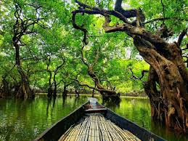
Ratargul Swamp Forest

Slide 2

Description
Ratargul Swamp Forest is a freshwater swamp forest located in Gowain River, Fatehpur Union, Gowainghat, Sylhet, Bangladesh. Ratargul was once thought to be the only swamp forest in Bangladesh,^{[1][2][3]} and one of the few freshwater swamp forests in the world. Later, more swamp forests namely Jugirkandi Mayabon, Bujir Bon and Lokkhi Baor swamp forest were discovered in Bangladesh.^{[4][5][6]}

Slide 3
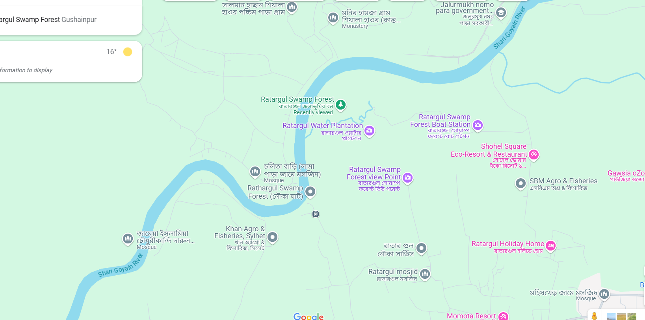

Location Ratargul is about 26 kilometres from Sylhet. There is a 3,325 acres wetland in Sylhet range-2 under the forest department and in that wetland Ratargul swamp forest is about 504 acres^{[11]} It is located in Gowainghat. After reaching Gowainghat, tourists reserve local engine boat namely "traller" to reach forest.^{[12]} There are two haors, Shimul Bil haor and Neoa Bil Haor, in the south part of the forest.^{[13]}

Slide 4
Tourists attraction
Tourists mostly go to see the forest in monsoon. One needs to take permission from the forest office to visit the forest. A local boat needs to be hired to travel through the swamp forest. There is a building tower inside the forest. If you go up there, you can see the whole view of the forest.^{[citation needed]}

Slide 5
Thank you

